Slide 1
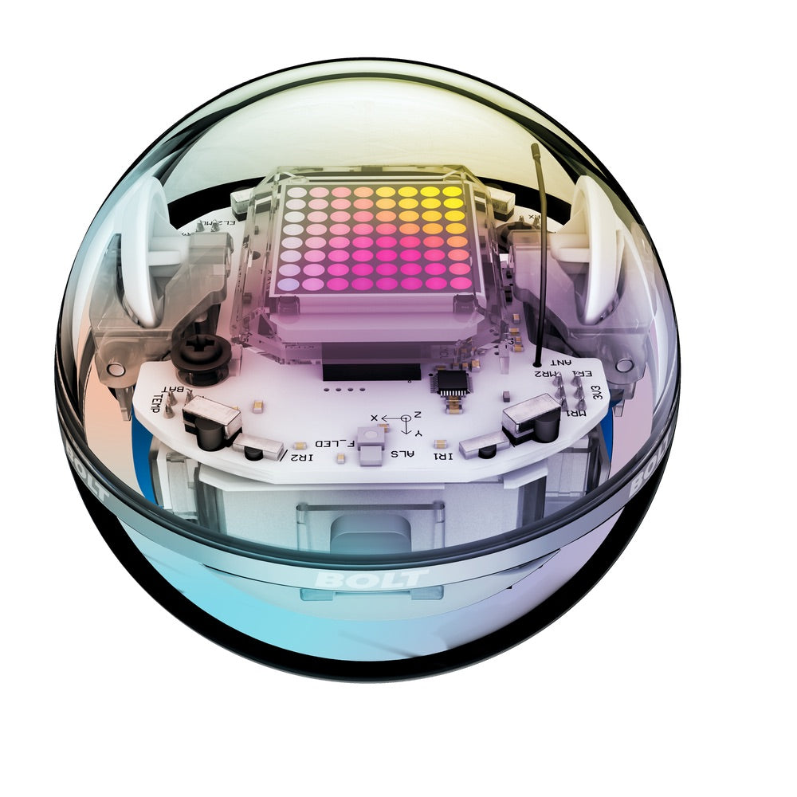
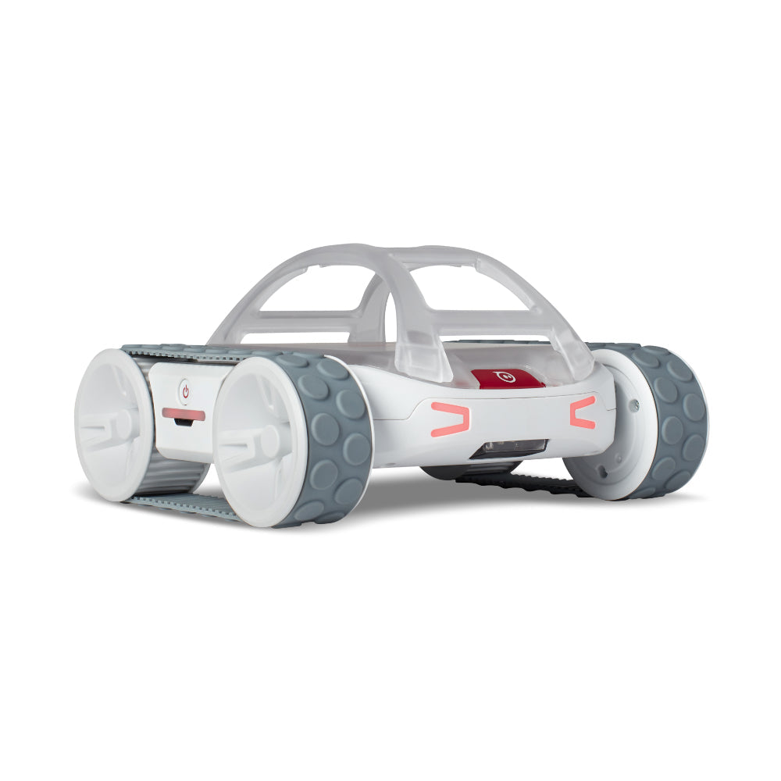
Heterogeneous Swarming of RVR & BOLT Robots

Slide 2
Update
Thesis goals:

Slide 3
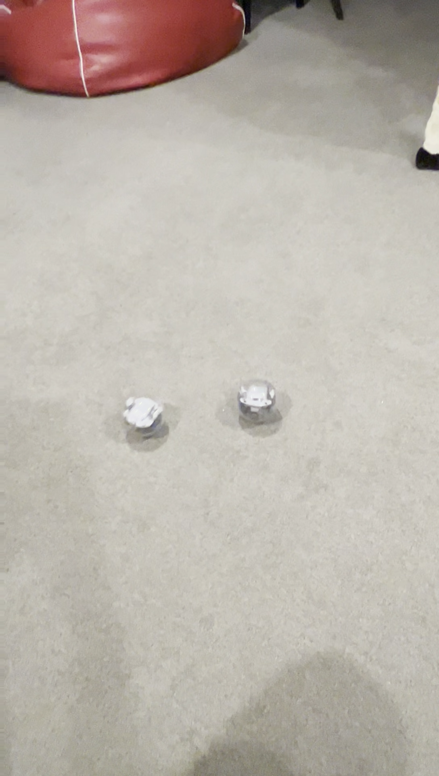
Current Work
IR communication between RVR and BOLT
Bluetooth communication between RVR and BOLT
Python implementation of RVR and BOLT as boids

Slide 4
Deliverables
Thesis paper
Project documentation
Research material
Software w/ documentation

